Slide 1
Understanding Array in Java
Dr. Naveen Kumar
Associate Professor
Amity Institute of Information Technology
Amity University Patna

Slide 2
Core Concepts
Homogeneous Data Arrays can only store elements of a single, consistent type, which can be either primitive data types (like int, char, boolean) or objects (like String, Integer, or user-defined classes).
Fixed Size The size of an array is determined when it is created (instantiated) and cannot be changed afterward. To use a dynamic, resizable collection, the ArrayList class is recommended.
Zero-Indexed The first element of an array is accessed using index 0, the second at index 1, and so on, up to array.length - 1.
Objects in Java Arrays are objects and implicitly inherit from java.lang.Object. Memory for arrays is dynamically allocated on the heap segment.

Slide 3
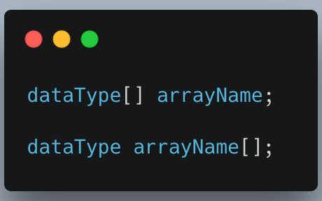
Array in Java
In Java, you can declare an array in several ways, often combining the declaration with allocation and initialization. Arrays in Java are objects with a fixed size once created.
The main ways to declare a single-dimensional array are:
Declaration Only This approach declares a variable as an array type but does not create the actual array object or allocate memory.
Example: int[] numbers;

Slide 4
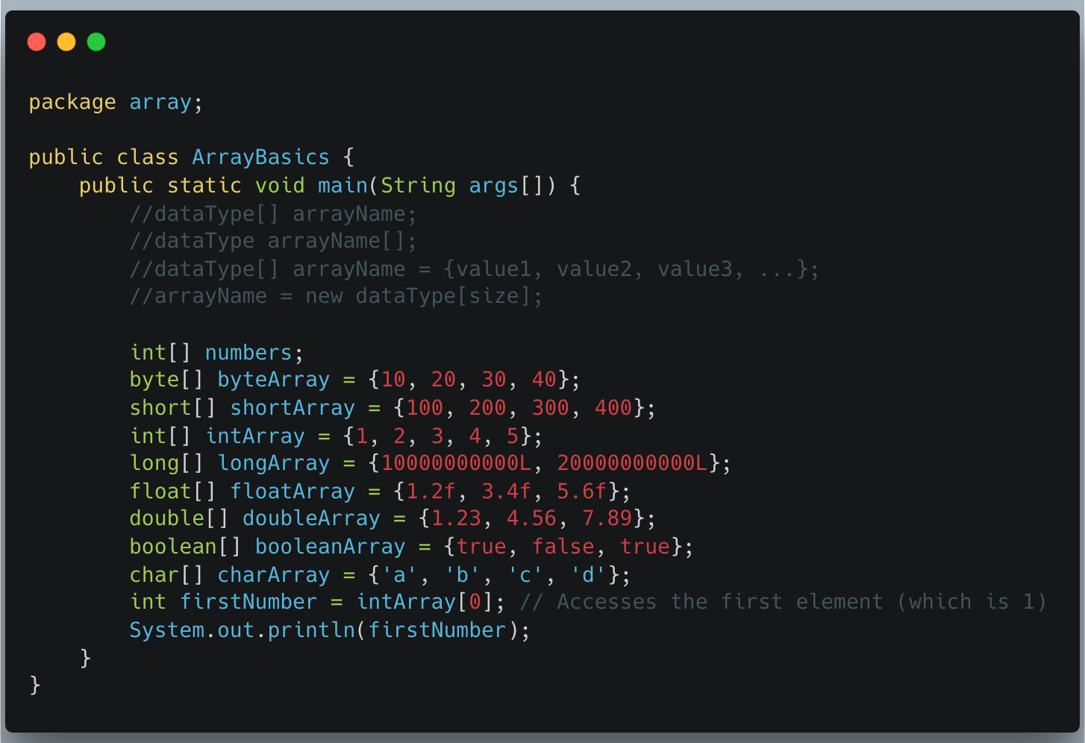

Slide 5
Datatype | Description | Size | Range | Default Value
Byte | 8 bits signed integer | 1 byte | -128 to 127 | 0
Short | 32 bits signed integer | 4 bytes | -32,768 to 32,767 | 0
Int | 32 bits signed integer | 4 bytes | -2,147,483,648 to 2,147,483,647 | 0
Long | 64 bits signed integer | 8 bytes | -9,223,372,036,854,775,808 to 9,223,372,036,854,775,807 | 0L
Float | 32-bit single-precision floating-point number | 4 bytes | Sufficient for 6 to 7 decimal digits of precision | 0.0f
Double | 64-bit double-precision floating-point number | 8 bytes | Sufficient for 15 to 16 decimal digits of precision | 0.0d
Boolean | Logical values | JVM dependent (approx. 1 bit) | True or false | False
Char | Single 16-bit Unicode character | 2 bytes | \u0000 to \uffff (0 to 65,535) | \u0000

Slide 6
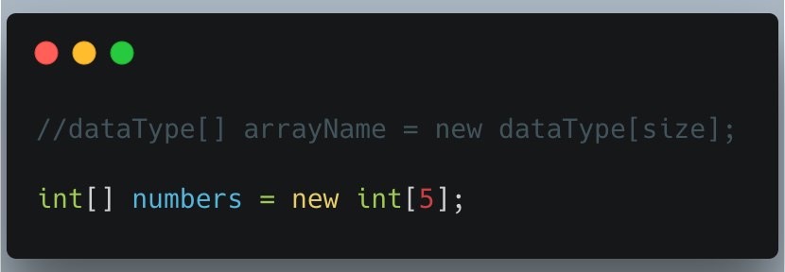
Array in Java
Declaration and Memory Allocation (without immediate values) This method declares the array and allocates memory for a specific number of elements using the new keyword. The elements are automatically initialized to default values (e.g., 0 for int, null for objects, false for boolean).

Slide 7
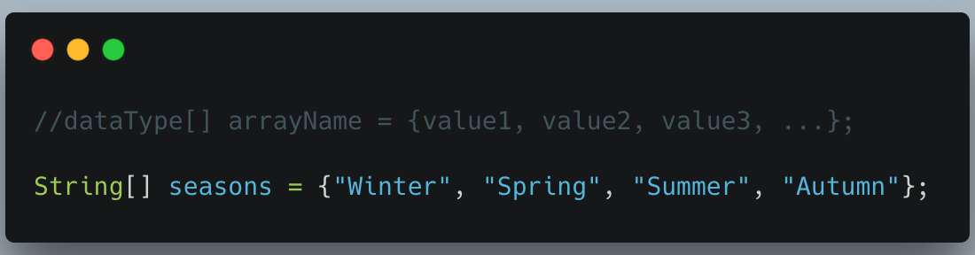
Array in Java
Declaration and Initialization using an Array Literal (Shortcut Syntax) This is the most common and concise way when you know the values beforehand. The size of the array is determined implicitly by the number of values provided in the curly braces {}. The new keyword is optional in this specific context.

Slide 8
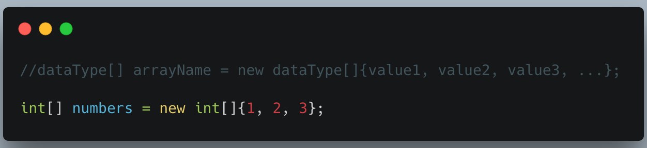
Array in Java
Declaration and Initialization using new with an Array Literal This method is similar to the shortcut but explicitly uses the new keyword. This syntax is required if you declare the array variable first and initialize it later, or when passing an array as an anonymous argument to a method.

Slide 9
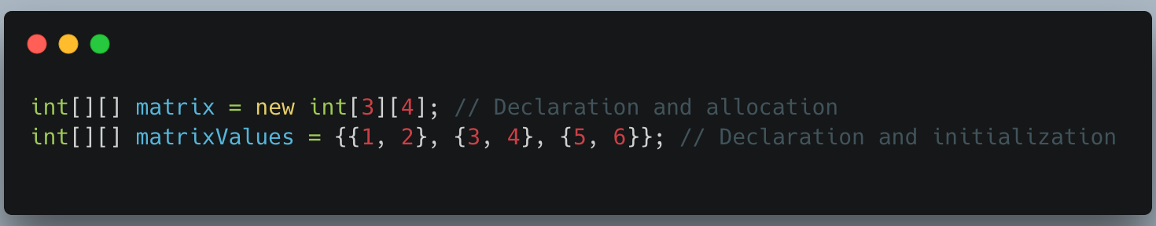
Array in Java
For multidimensional arrays, you use similar patterns with multiple sets of brackets:
Two-Dimensional Array Examples

Slide 10
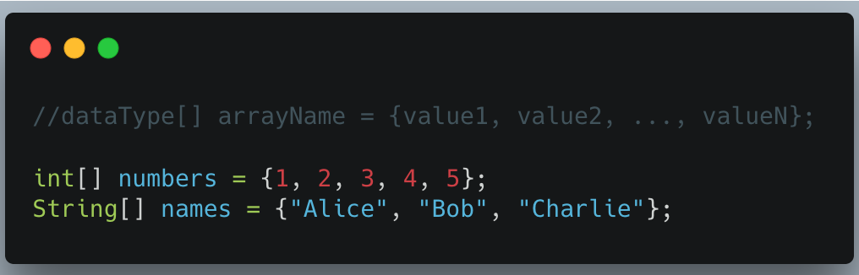
Method 1: Initialization at Declaration
You can initialize an array at the time of declaration using curly braces {} with the values separated by commas.
Syntax
dataType[] arrayName = {value1, value2, ..., valueN};

Slide 11
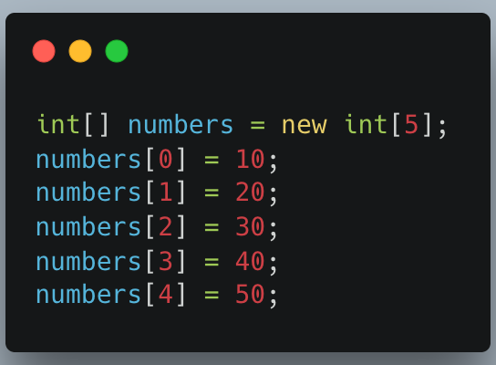
Method 2: Using the new Keyword
You can also use the new keyword to allocate memory for the array and then assign values to each index.
Syntax: dataType[] arrayName = new dataType[arraySize];

Slide 12
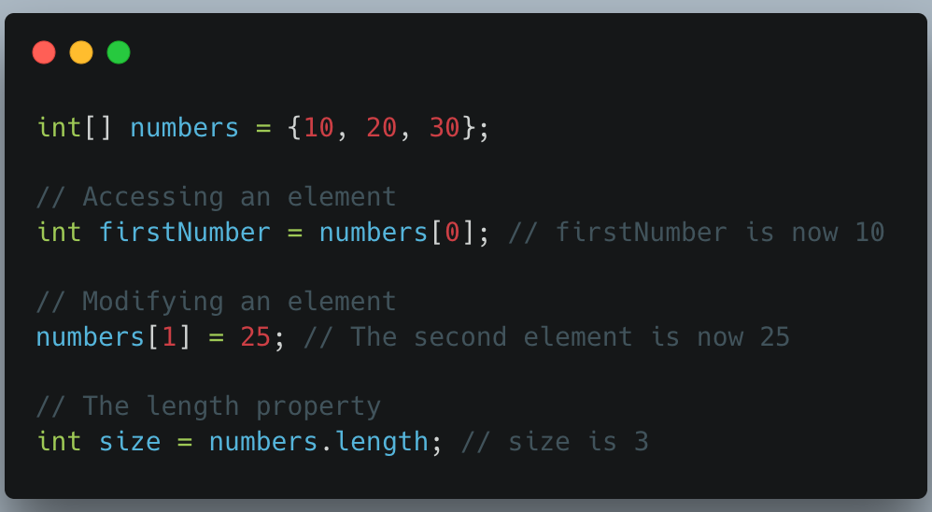
Accessing and Modifying Elements
Elements are accessed or modified using their index within square brackets:

Slide 13
Accessing an invalid index (negative or greater than/equal to the array's length) will result in an ArrayIndexOutOfBoundsException at runtime.

Slide 14
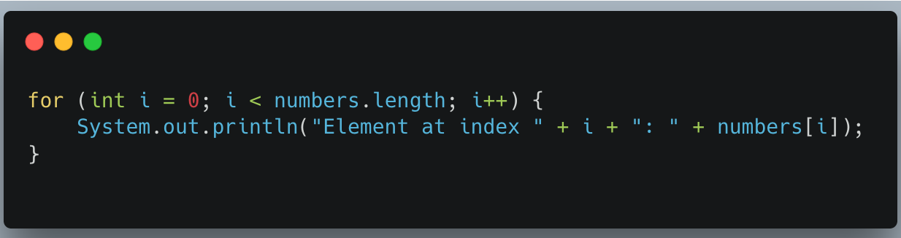
Iterating Through Arrays
Arrays are often processed using loops:
Standard for loop (for index control):

Slide 15
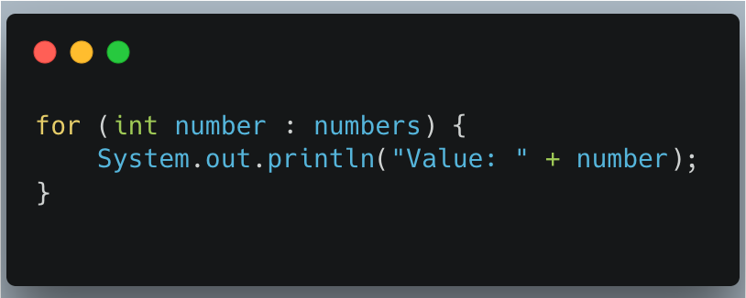
Iterating Through Arrays
Enhanced for-each loop (for simpler iteration over values):

Slide 16
Use Arrays Utility Class: Java provides the java.util.Arrays class with utility methods for array manipulation, such as sort(), fill(), and toString() for easy handling of arrays.

Slide 17
Core Array Operations
The primary operations on arrays in Java involve managing and manipulating their elements:
Declaration: Declaring an array creates a reference variable that can point to an array object.
int[] numbers; // The preferred Java style
Initialization (Allocation): This is where memory is allocated for the array using the new keyword, and its size is determined. Elements are automatically initialized to default values (e.g., 0 for int, null for objects).
numbers = new int[5];
// Combined declaration and initialization
int[] age = {12, 4, 5, 2, 5};

Slide 18
Accessing Elements: Elements are accessed using a zero-based index within square brackets [].
int firstNumber = age[0]; // Accesses the first element (12)
Updating Elements: The value of an element at a specific index can be changed by assigning a new value to it.
age[0] = 20; // Changes the first element to 20

Slide 19
Traversal: Iterating through all elements, typically using a for loop or an enhanced for-each loop.
// Using a for-each loop
for (int value : age) {
System.out.println(value);
}
// Using a standard for loop
for (int i = 0; i < age.length; i++) {
System.out.println(age[i]);
}
Length: The number of elements an array can hold is accessed using the length property.
int size = age.length; // size will be 5

Slide 20
Utility Operations with java.util.Arrays
Java provides the powerful java.util.Arrays class to simplify common array operations.
Sorting: Arranges elements in ascending order.
import java.util.Arrays;
Arrays.sort(age); // Sorts the 'age' array
Searching: The binarySearch() method efficiently finds the index of a value in a sorted array.
int index = Arrays.binarySearch(age, 5); // Finds the index of the value 5

Slide 21
Copying/Cloning: Creates a new array with the same elements.
int[] newAge = age.clone();
// Alternatively, using Arrays.copyOf()
int[] copiedAge = Arrays.copyOf(age, age.length);
Filling: Assigns a specific value to all elements of an array.
Arrays.fill(newAge, 10); // Fills newAge array with the value 10
Converting to String: Provides a readable string representation of the array's contents, which is useful for printing and debugging.
System.out.println(Arrays.toString(age)); // e.g., "[2, 4, 5, 5, 12]"

Slide 22
Java Array in Competitive Programming
In competitive programming, Java arrays are a fundamental and highly efficient data structure, prized for their fast, constant-time (O(1)) random access to elements. They are used as the foundation for various algorithms and other data structures like ArrayList, but their fixed size requires careful memory management and can make insertions/deletions slow.

Slide 23
Key Characteristics in Competitive Programming
Speed and Efficiency: Arrays offer O(1) time complexity for accessing and modifying elements by index due to their contiguous memory allocation. This is a critical advantage in performance-sensitive scenarios where solutions must meet strict time limits.
Fixed Size: A significant characteristic of Java arrays is their fixed length once created. This means dynamic resizing (like in ArrayList) requires creating a new, larger array and copying all elements, an O(n) operation that can be time-consuming during a contest.
Memory Management: Arrays of primitive types (like int, long) store the values directly in contiguous memory, making them memory-efficient and cache-friendly. Arrays of objects store only the references contiguously, with the actual objects stored elsewhere in the heap.
Utility Class: The java.util.Arrays class provides several static methods for common operations like sort(), binarySearch(), fill(), and toString(), which save time and reduce boilerplate code.

Slide 24
Essential Techniques and Usage
Frequency Counting: Arrays are ideal for counting element frequencies efficiently when the range of values is limited (e.g., using element values as indices in a count array).
Prefix Sums and Sliding Window: These popular algorithm techniques rely heavily on the fast, indexed access of arrays to pre-compute values or iterate through subarrays efficiently.
Matrix Operations: Two-dimensional arrays (matrices) are commonly used to represent grids, graphs (adjacency matrices), and tabular data for problems involving dynamic programming or grid traversals.
Sorting: While Arrays.sort() is convenient, be mindful that for primitive types it uses a Quicksort variation which has a worst-case time complexity of O(n²), potentially leading to a Time Limit Exceeded (TLE) error on certain test cases.
To mitigate the Quicksort worst-case issue, one can use the object wrapper class (e.g., Long instead of long) as Arrays.sort() on object arrays uses a stable Mergesort with a guaranteed O(n log n) worst-case runtime.
Input Processing: For competitive programming, efficient input reading for arrays often involves using Java 8 streams or a custom Scanner/BufferedReader setup to quickly parse input strings into integer arrays.

Slide 25
Summary of Common Operations
Operations | Time Complexity Avarage Case | Notes
Access element by index | O(1) | Very fast due to direct memory access.
Search (Linear) | O(n) | Simple traversal is linear time.
Search (Binary) | O(logn) | Requires a sorted array; use Arrays.binarySearch().
Insertion/Deletion | O(n) | Elements must be shifted to accommodate the change.
Sorting | O(n logn) | Arrays.sort() is efficient, but be mindful of worst-case scenarios with primitives.
Mastering array manipulation and understanding their performance trade-offs
is crucial for success in coding interviews and competitive programming challenges.

Slide 26
Array Class in Java
The primary array utility class in Java is java.util.Arrays, which provides a comprehensive set of static methods for common operations on arrays, such as sorting, searching, comparing, and converting them to strings.

Slide 27
Key Features of java.util.Arrays
Static Methods: All methods in the class are static, meaning you call them directly using the class name, e.g., Arrays.sort(myArray). This class cannot be instantiated.
Overloaded Methods: Most methods are overloaded to handle all primitive data types (like int, double, char, etc.) as well as object types.
Efficiency: These methods are optimized (e.g., sort uses a highly efficient dual-pivot Quicksort for primitives and a stable merge sort for objects).

Slide 28
Common Methods
Here are some of the most frequently used methods available in the java.util.Arrays class:
sort(): Sorts the elements of an array in ascending order. Overloaded versions allow sorting an entire array or a specific range, and for object arrays, a custom Comparator can be provided.
binarySearch(): Searches for a specified value in a sorted array using the binary search algorithm. It returns the index of the element if found, or a negative value indicating the insertion point if not found.
toString(): Returns a string representation of the contents of the array, which is helpful for printing and debugging. It presents the elements within square brackets, separated by commas (e.g., [1, 2, 3]).
equals(): Compares two arrays to determine if they are equal based on their contents. Two arrays are considered equal if they contain the same number of elements and all corresponding pairs of elements are equal.

Slide 29
Common Methods
deepEquals(): Similar to equals(), but designed for comparing the contents of multi-dimensional arrays.
fill(): Fills all elements of an array (or a specified range) with a given static value.
copyOf() and copyOfRange(): Creates a new array that is a copy of the original array, optionally truncating or padding with default values to meet a specified length.
asList(): Converts an array into a fixed-size List. This list is "backed" by the original array, meaning changes in the list are reflected in the array and vice versa. The size of the list cannot be changed (adding or removing elements throws an UnsupportedOperationException).
stream(): Returns a sequential Stream with the array as its source (available since Java 8).

Slide 30
Insert Operations in Array
In Java, arrays have a fixed size once they are created. This means you cannot "grow" a standard array. To perform an insertion, you typically need to ensure the array has enough "empty" slots (often initialized to zero or null) or create a new, larger array to hold the extra data.
Important Concepts
Capacity: The total size of the array (e.g., arr.length).
Size: The number of actual elements currently stored in the array.
Shifting: When you insert an element in the middle or at the start, you must move the existing elements to the right to make room.

Slide 31
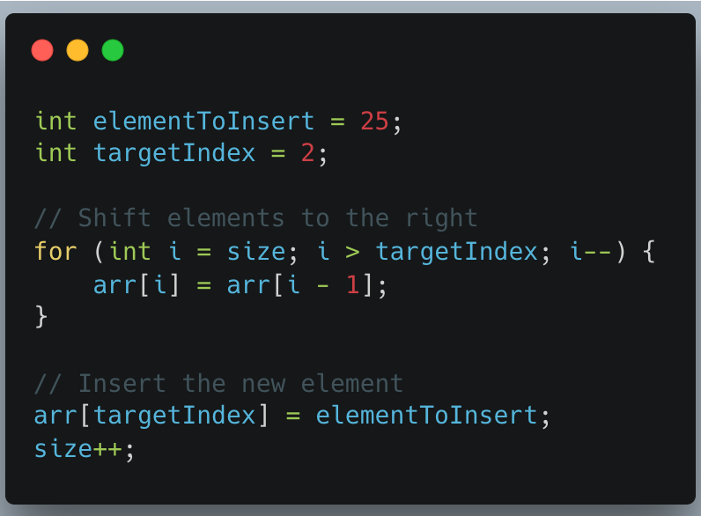
Insertion at a Specific Index
To insert an element at a specific index, you must shift all elements from that index one position to the right.

Slide 32
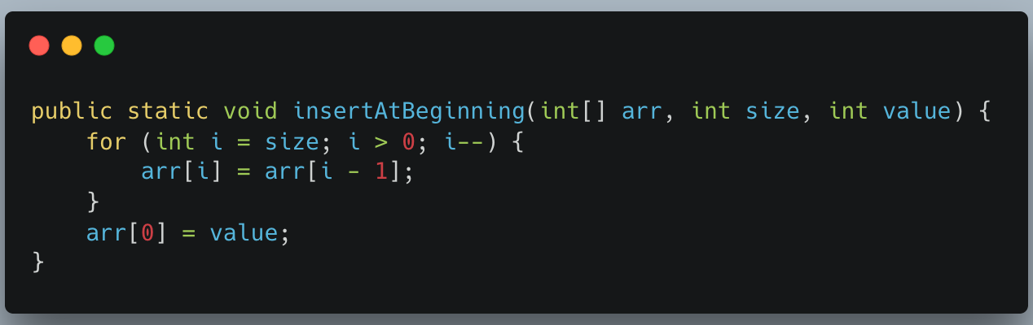
Insertion at the Beginning
This is a specific case of index insertion where the index is always 0. It is the most "expensive" operation because every existing element must be shifted.
Time Complexity: O(n)
Logic: Start from the last element and move it to i + 1 until you reach index 0.

Slide 33
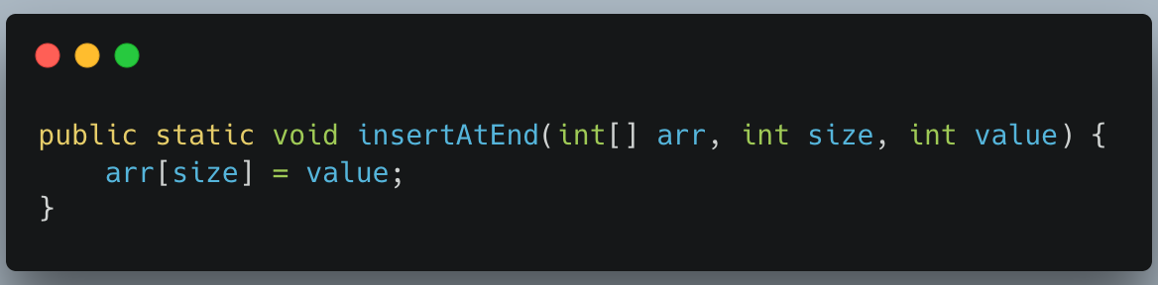
Insertion at the End
This is the most efficient insertion, provided the array has enough capacity. No shifting is required.
Time Complexity: O(1)
Logic: Simply place the element at the current size index.

Slide 34
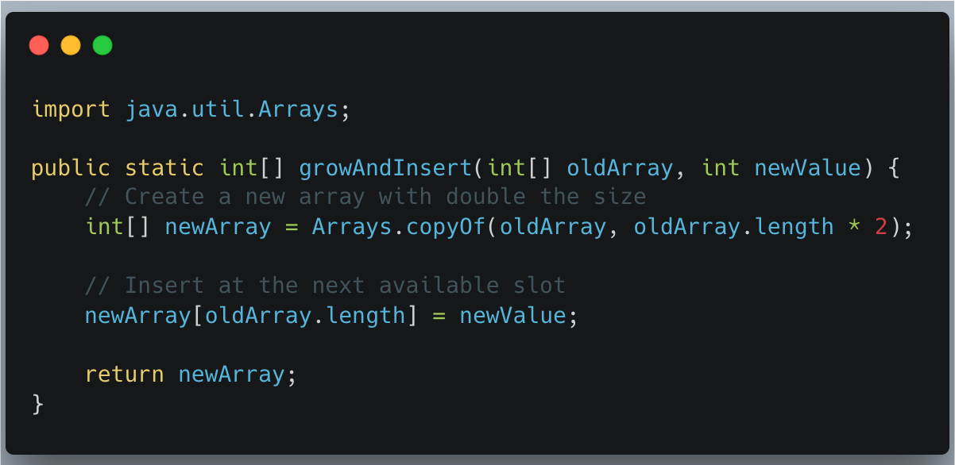
Handling a Full Array (Dynamic Resizing)
If the array is full (size == arr.length), you must create a new array with more capacity and copy the old elements over before inserting.
Java Implementation (Using Arrays.copyOf)

Slide 35
Operation | Shift Required | Time Complexity
InsertAtBegin | Yes (all elements) | O(n)
InsertAtEnd | No | O(1)
InsertAtIndex | Yes (elements from k to n) | O(n)

Slide 36
Delete Operations in Array
Deletion in a standard Java array is the opposite of insertion. Since arrays have a fixed size, you cannot truly "remove" a slot. Instead, you overwrite the element to be deleted by shifting all subsequent elements one position to the left.
Key Logic: The "Shift"
When you delete an element from the middle or the beginning, you create a "hole." To maintain the array's integrity, every element to the right of the deleted item must move left by one index.

Slide 37
Deletion at a Specific Index
This is the most common deletion operation. You specify which position you want to clear, and the array collapses to fill it.
Time Complexity: $O(n)$ (because you may have to shift almost all elements).
Logic: Start at the targetIndex and set arr[i] = arr[i + 1].

Slide 38
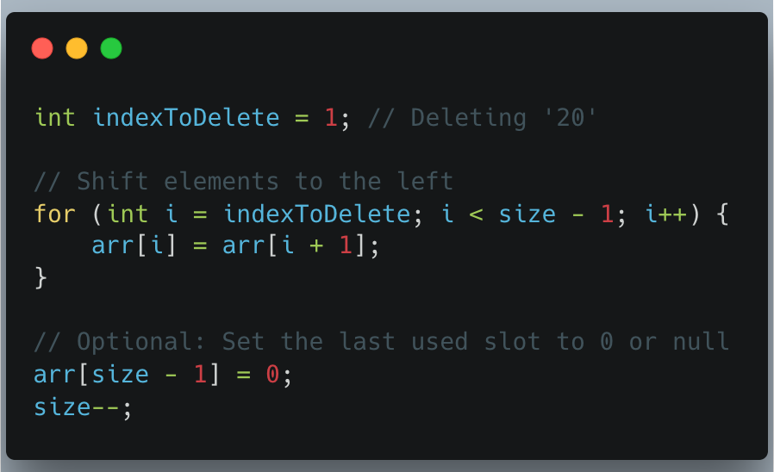

Slide 39
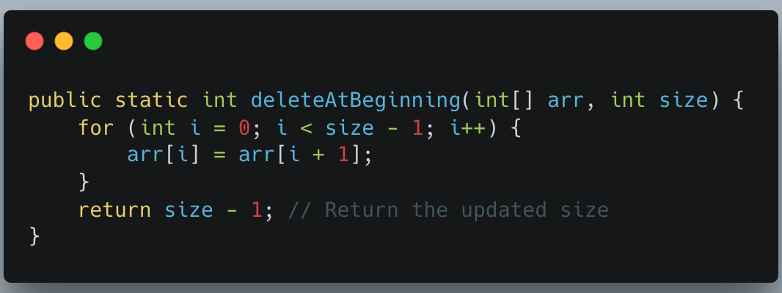
Deletion at the Beginning
This is the most expensive type of deletion because every single element in the array must be moved.
Time Complexity: O(n)
Logic: Loop from index 0 to size - 2, pulling the value from i + 1 into i.

Slide 40
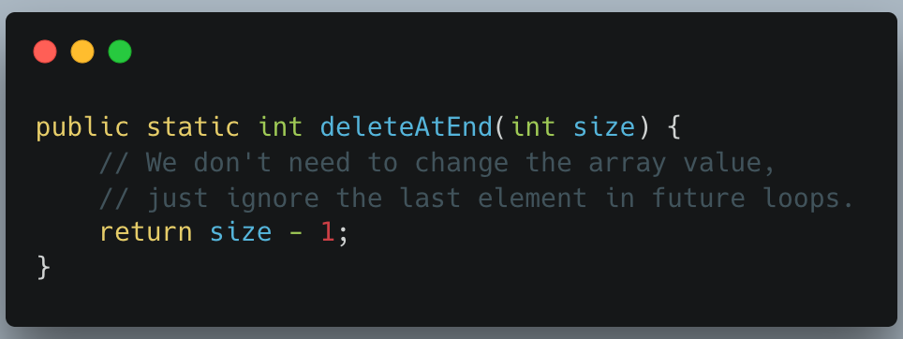
Deletion at the End
This is the most efficient deletion. You don't actually need to move any data; you simply stop tracking the last element.
Time Complexity: O(1)
Logic: Just decrement the size counter.

Slide 41
Stack

Slide 42
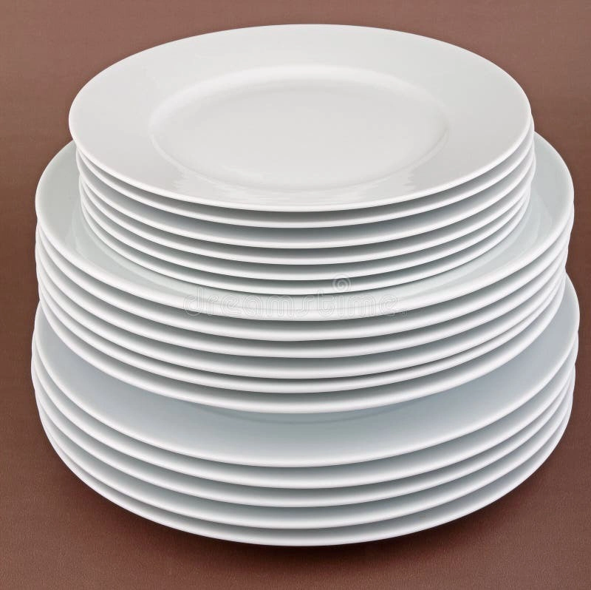

Slide 43
Real-World Applications of Stacks
Undo Functionality: In text editors or graphic design software, each action is pushed onto a stack. When you hit "undo," the most recent action is popped off the stack and reversed.
Browser History: When you visit a new page, it's pushed onto a stack. The "back" button pops the current page off the stack, revealing the previous one.
Function Call Stack: In programming languages, function calls are managed using a stack. When a function is called, it's pushed onto the call stack. When it returns, it's popped off.
Expression Evaluation: Stacks are used to evaluate arithmetic expressions, especially those in postfix notation.
Backtracking Algorithms: In problems like maze-solving or puzzle-solving, stacks can keep track of the path taken, allowing easy backtracking when needed.

Slide 44
Queue Data Structure
A queue is a linear data structure that follows the First-In-First-Out (FIFO) principle, where elements are inserted at the rear and removed from the front. This ordering ensures that the oldest elements are processed first, making queues ideal for scenarios such as task scheduling, event handling, and resource allocation.

Slide 45
Types of Queues
Linear Queue: A basic queue where elements are stored in a linear fashion and accessed sequentially.
Circular Queue: A queue with a fixed-size buffer that wraps around when the rear reaches the end, enabling efficient use of memory.
Priority Queue: A specialized queue where elements are dequeued based on their priority level, rather than the order of insertion.

Slide 46
Basic Operations on Queues:
Enqueue() : Adding an element to the rear of the queue.

Slide 47
2. Dequeue() : Removing an element from the front of the queue.

Slide 48
3. Traverse() : Iterating through the queue to access and process each element sequentially.

Slide 49
4. isEmpty() : This is our own customized function to see whether the queue is empty or not.

Slide 50
Practical Implementation
Queues find applications in various domains, including:
Operating Systems: Task scheduling, process management, and I/O request handling.
Networking: Packet switching, message queuing, and congestion control.
Data Structures: Implementing other abstract data types such as stacks and trees.

Slide 51
Best Practices and Considerations
When working with queues, it's essential to consider:
Synchronization: Implementing thread-safe operations for concurrent access in multi-threaded environments.
Memory Management: Proper allocation and deallocation of memory to avoid memory leaks and buffer overflows.
Performance Optimization: Implementing efficient algorithms and data structures for enqueueing, dequeueing, and traversal operations.
Error Handling: Handling edge cases such as queue underflow and overflow gracefully to ensure robustness and reliability.

